Slide 1
Unit 3 FACTORING POLYNOMIALS
Algebra 1

Slide 2
FACTORING OUT THE GCF
$${20w}^{10}+ {32w}^{8}$$
$${−4x}^{7}− {2x}^{3}$$

Slide 3
FACTORING OUT THE GCF
$${18x}^{3}y− {27x}^{8}y^{4}$$
$${−6x}^{3}+ {2x}^{6}+14$$

Slide 4
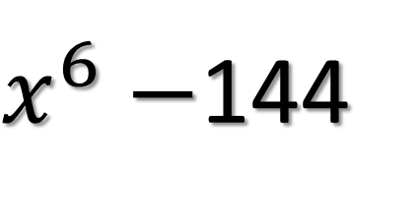
Difference of Two Squares
$$x^{2}−36$$
Factor Out a GCF. (If Possible)
Find the Squares of the First Term
Find the Squares of the Last Term
Put the 1st Term in the 1st Place of Each (), Put the Last Term in the 2nd Place of Each ()
$x^{6}−$144
$$a^{2}−b^{2}=(a+b)(a−b)$$

Slide 5
Difference of Two Squares
$${25x}^{2}−64$$
Factor Out a GCF. (If Possible)
Find the Squares of the First Term
Find the Squares of the Last Term
Put the 1st Term in the 1st Place of Each (), Put the Last Term in the 2nd Place of Each ()
$${4k}^{4}−{100h}^{2}$$
$$a^{2}−b^{2}=(a+b)(a−b)$$

Slide 6
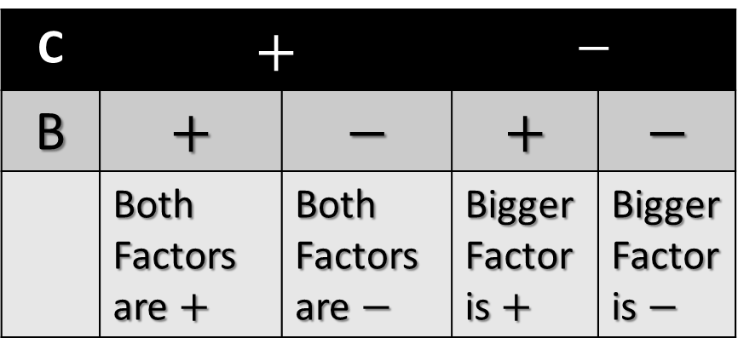
TRINOMIALS (A = 1)
$$d^{2}+3d−18$$
Check for GCF
Write two sets of parenthesis,
( )( ). These will be the factors of the trinomial.
Think of factors of c that add up to b. (Use Chart for Signs)
C | $$+$$ |  | $$−$$
B | $$+$$ | $$−$$ | $$+$$ | $$−$$
 | Both Factors are $+$ | Both Factors are $−$ | Bigger Factor is $+$ | Bigger Factor is $−$

Slide 7
TRINOMIALS (A = 1)
$$d^{2}+11d+28$$
Check for GCF
Write two sets of parenthesis,
( )( ). These will be the factors of the trinomial.
Think of factors of c that add up to b. (Use Chart for Signs)
C | $$+$$ |  | $$−$$
B | $$+$$ | $$−$$ | $$+$$ | $$−$$
 | Both Factors are $+$ | Both Factors are $−$ | Bigger Factor is $+$ | Bigger Factor is $−$

Slide 8
TRINOMIALS (A = 1)
$$k^{2}+6kf−27f^{2}$$
Check for GCF
Write two sets of parenthesis,
( )( ). These will be the factors of the trinomial.
Think of factors of c that add up to b. (Use Chart for Signs)
C | $$+$$ |  | $$−$$
B | $$+$$ | $$−$$ | $$+$$ | $$−$$
 | Both Factors are $+$ | Both Factors are $−$ | Bigger Factor is $+$ | Bigger Factor is $−$

Slide 9
TRINOMIALS (A = 1)
$${2x}^{3}+16x^{2}−40x$$
Check for GCF
Write two sets of parenthesis,
( )( ). These will be the factors of the trinomial.
Think of factors of c that add up to b. (Use Chart for Signs)
C | $$+$$ |  | $$−$$
B | $$+$$ | $$−$$ | $$+$$ | $$−$$
 | Both Factors are $+$ | Both Factors are $−$ | Bigger Factor is $+$ | Bigger Factor is $−$

Slide 10
TRINOMIALS (A = 1)
$${−9x}^{3}−18x^{2}+135x$$
Check for GCF
Write two sets of parenthesis,
( )( ). These will be the factors of the trinomial.
Think of factors of c that add up to b. (Use Chart for Signs)
C | $$+$$ |  | $$−$$
B | $$+$$ | $$−$$ | $$+$$ | $$−$$
 | Both Factors are $+$ | Both Factors are $−$ | Bigger Factor is $+$ | Bigger Factor is $−$

Slide 11
TRINOMIALS (A = 1)
$${0.4x}^{2}−2.8x+4$$
Check for GCF
Write two sets of parenthesis,
( )( ). These will be the factors of the trinomial.
Think of factors of c that add up to b. (Use Chart for Signs)
C | $$+$$ |  | $$−$$
B | $$+$$ | $$−$$ | $$+$$ | $$−$$
 | Both Factors are $+$ | Both Factors are $−$ | Bigger Factor is $+$ | Bigger Factor is $−$

Slide 12
TRINOMIALS (A = 1)
$${0.3x}^{2}−3.3x+5.4$$
Check for GCF
Write two sets of parenthesis,
( )( ). These will be the factors of the trinomial.
Think of factors of c that add up to b. (Use Chart for Signs)
C | $$+$$ |  | $$−$$
B | $$+$$ | $$−$$ | $$+$$ | $$−$$
 | Both Factors are $+$ | Both Factors are $−$ | Bigger Factor is $+$ | Bigger Factor is $−$

